Slide 1
Claims based authentication

Slide 2
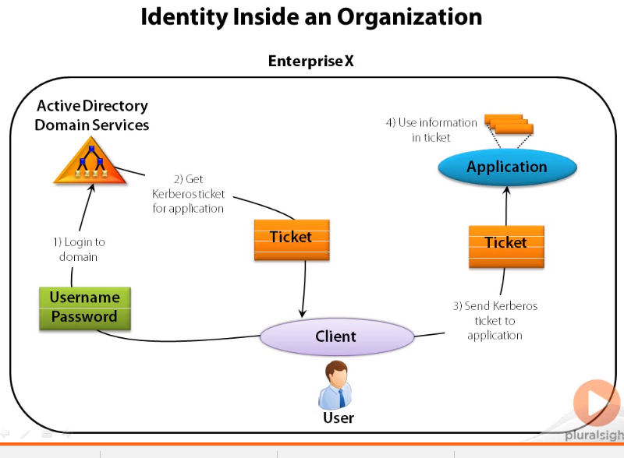
Identity inside authentication

Slide 3
Why we need claims based authentication
For intranet passing the Kerberose ticket as claims based authentication but what if application is also accessed by the outside the intranet

Slide 4
Solution is claims based identity
Why use different identity technologies
A common approach would make life simpler for application developers
And for users too
Claims based identity provides common approach

Slide 5
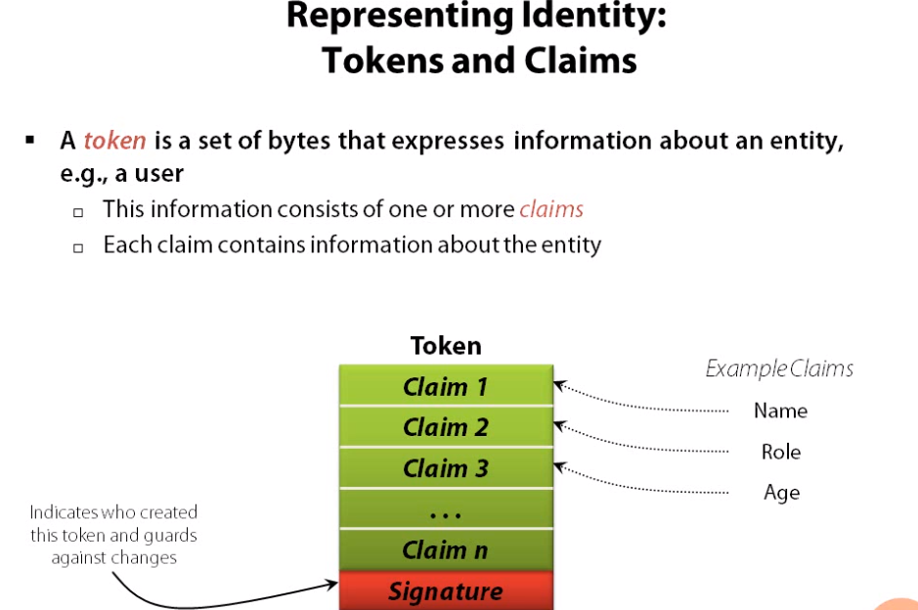

Slide 6
STS
A token is created by STS (Security Token Service)
STS is software know how to create token
Most popular SAML – Security assertion markup language
Identity providers works with STS
If you are working in organization and you need access, it is your employer who act as the identity provider
On the internet there are lot of other options Facebook, google, Microsoft. They provide STS.

Slide 7
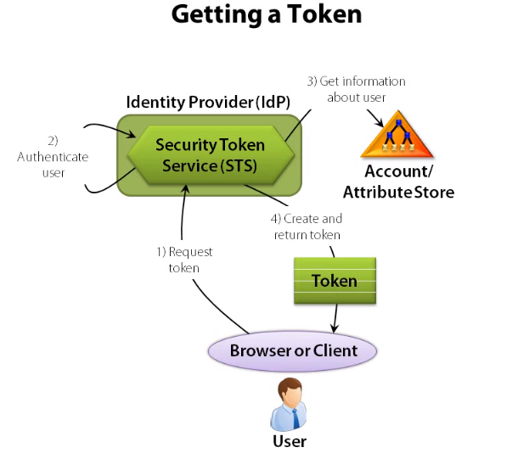
Flow -1

Slide 8
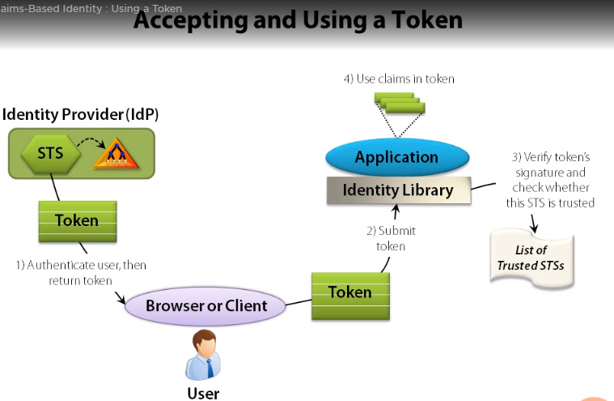
Flow-2

Slide 9
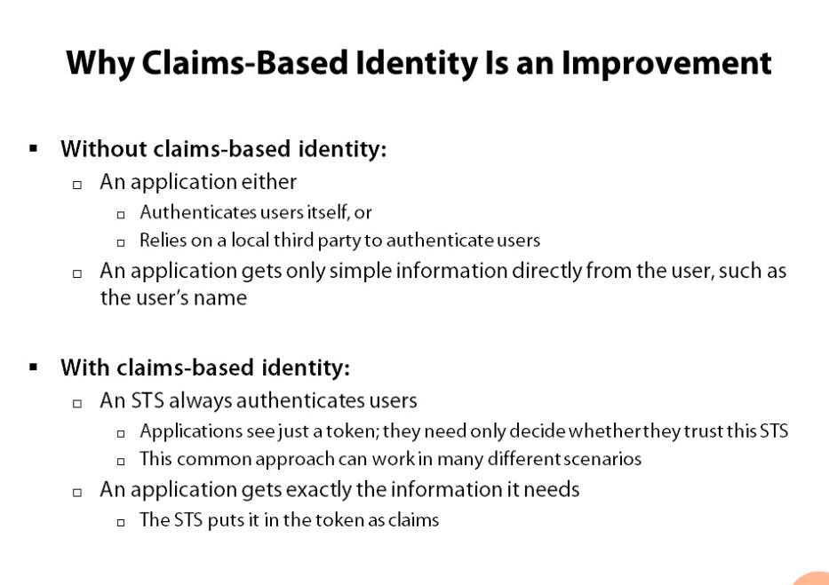

Slide 10
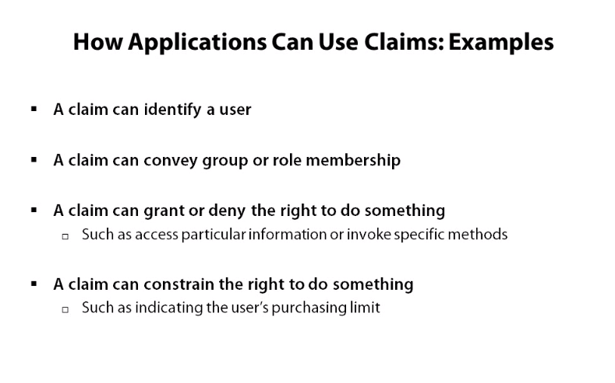

Slide 11
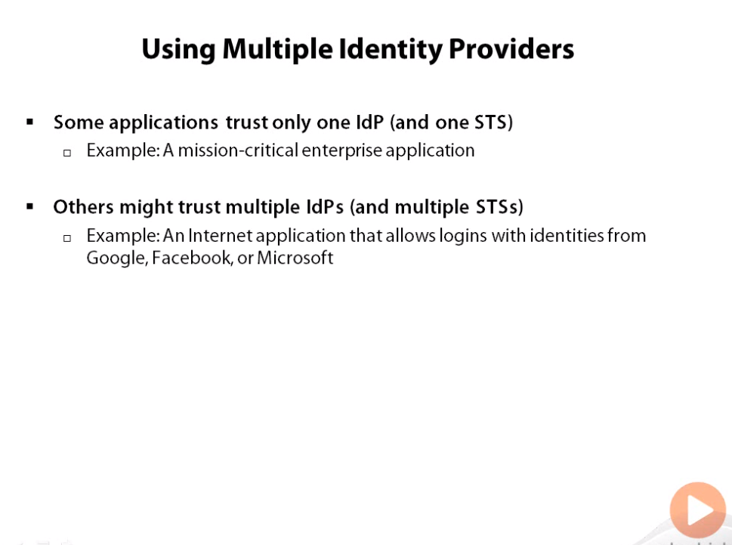

Slide 12
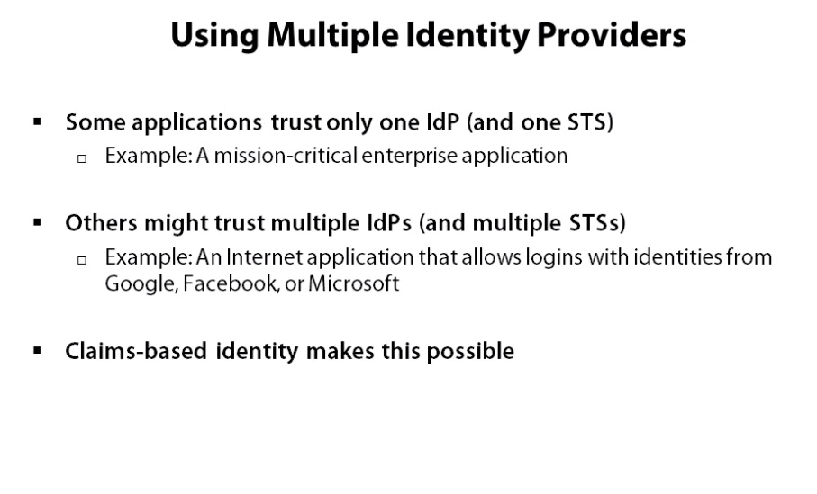

Slide 13
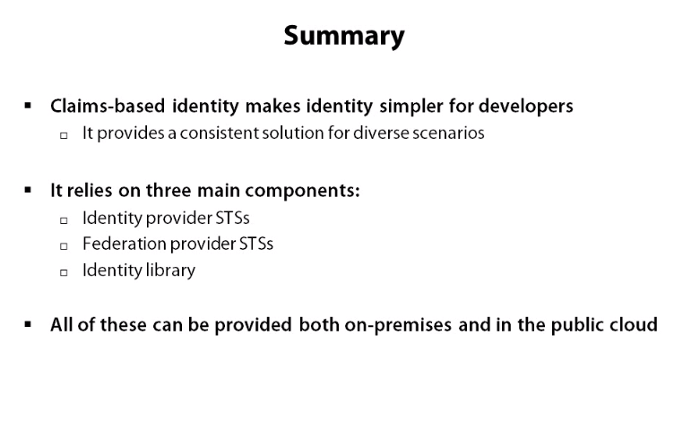

Slide 14
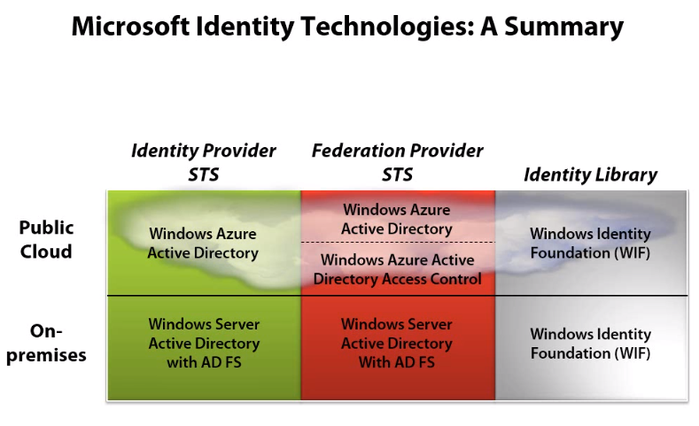

Slide 15
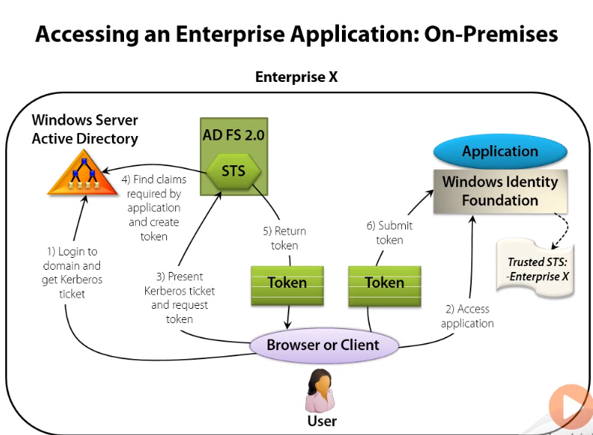

Slide 16
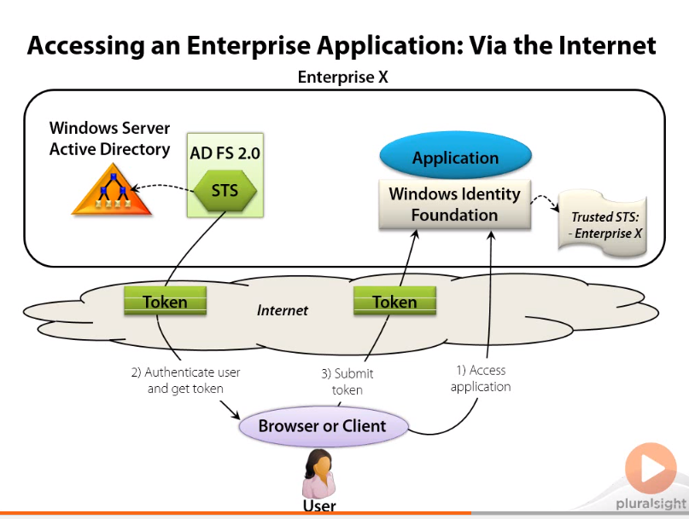

Slide 17
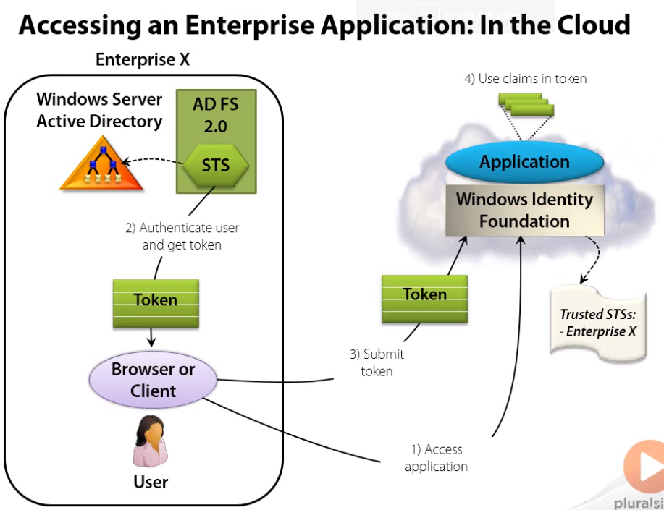

Slide 18
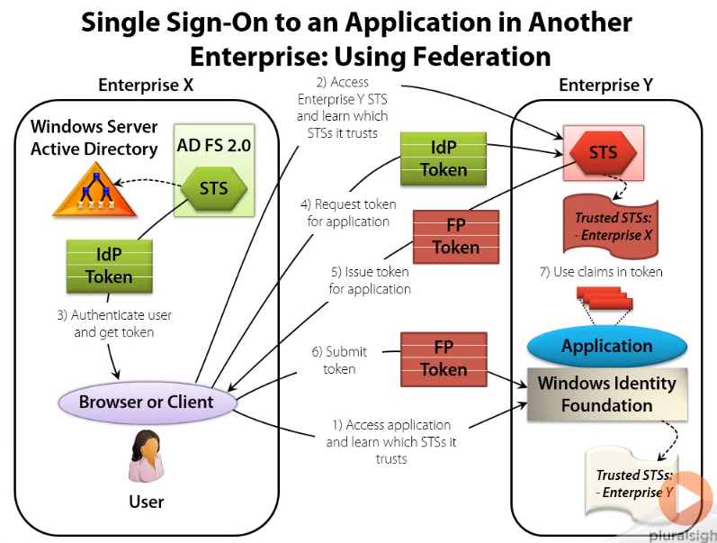

Slide 19
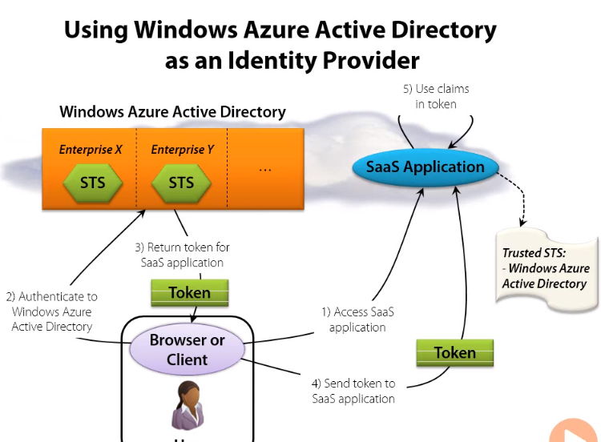

Slide 20
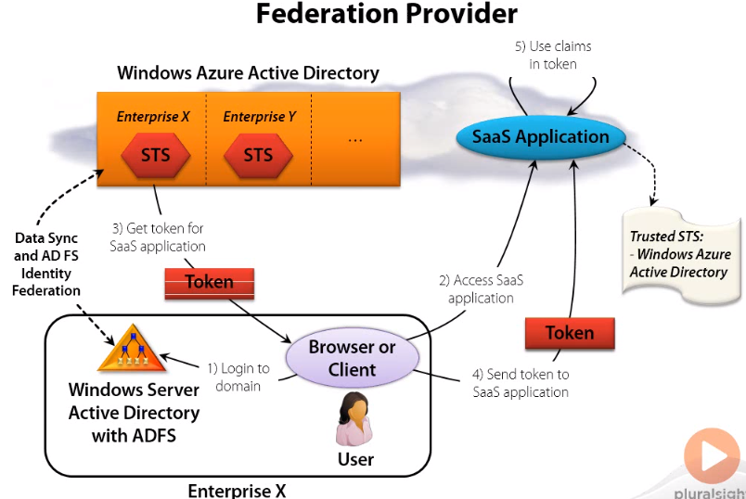
Active directory federation provider cloud

